Slide 1


Programming Your Way Up A Skyscraper
Python in the Built World
PYCASCADES 2022

Slide 2

ABOUT ME
Tadeh Hakopian
(Todd-A) (Ha-co-pea-on)
Design Technologist and Developer
Background in Architecture
Experience in Architecture, Engineering and Construction disciplines with BIM and VDC workflows
Course Author and Speaker for BIM, Dynamo and Coding content

Slide 3
TAKEAWAY
Python Makes it possible!
Showcase of how Python can support Architects and designers

Slide 4
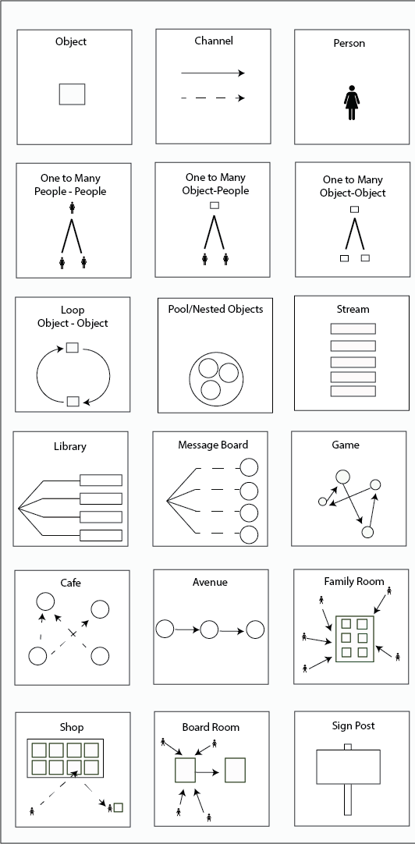
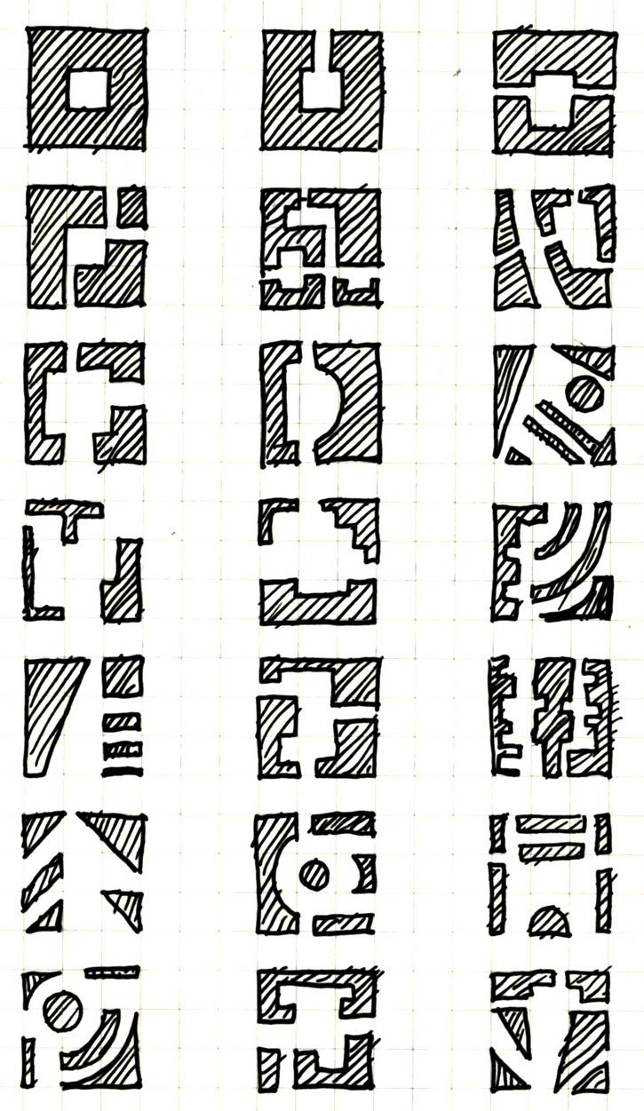
ARCHITECTS AND ARCHITECTS
Christopher Alexander’s Pattern Language has been a big influence
In a nutshell a pattern can be reused at any scale without reinventing the whole process
Used by Building Architects and Software Architects as a philosophy for design
Common ground for systems architecture in both disciplines and a point of discussion
BUILDINGS
SYSTEMS

Slide 5
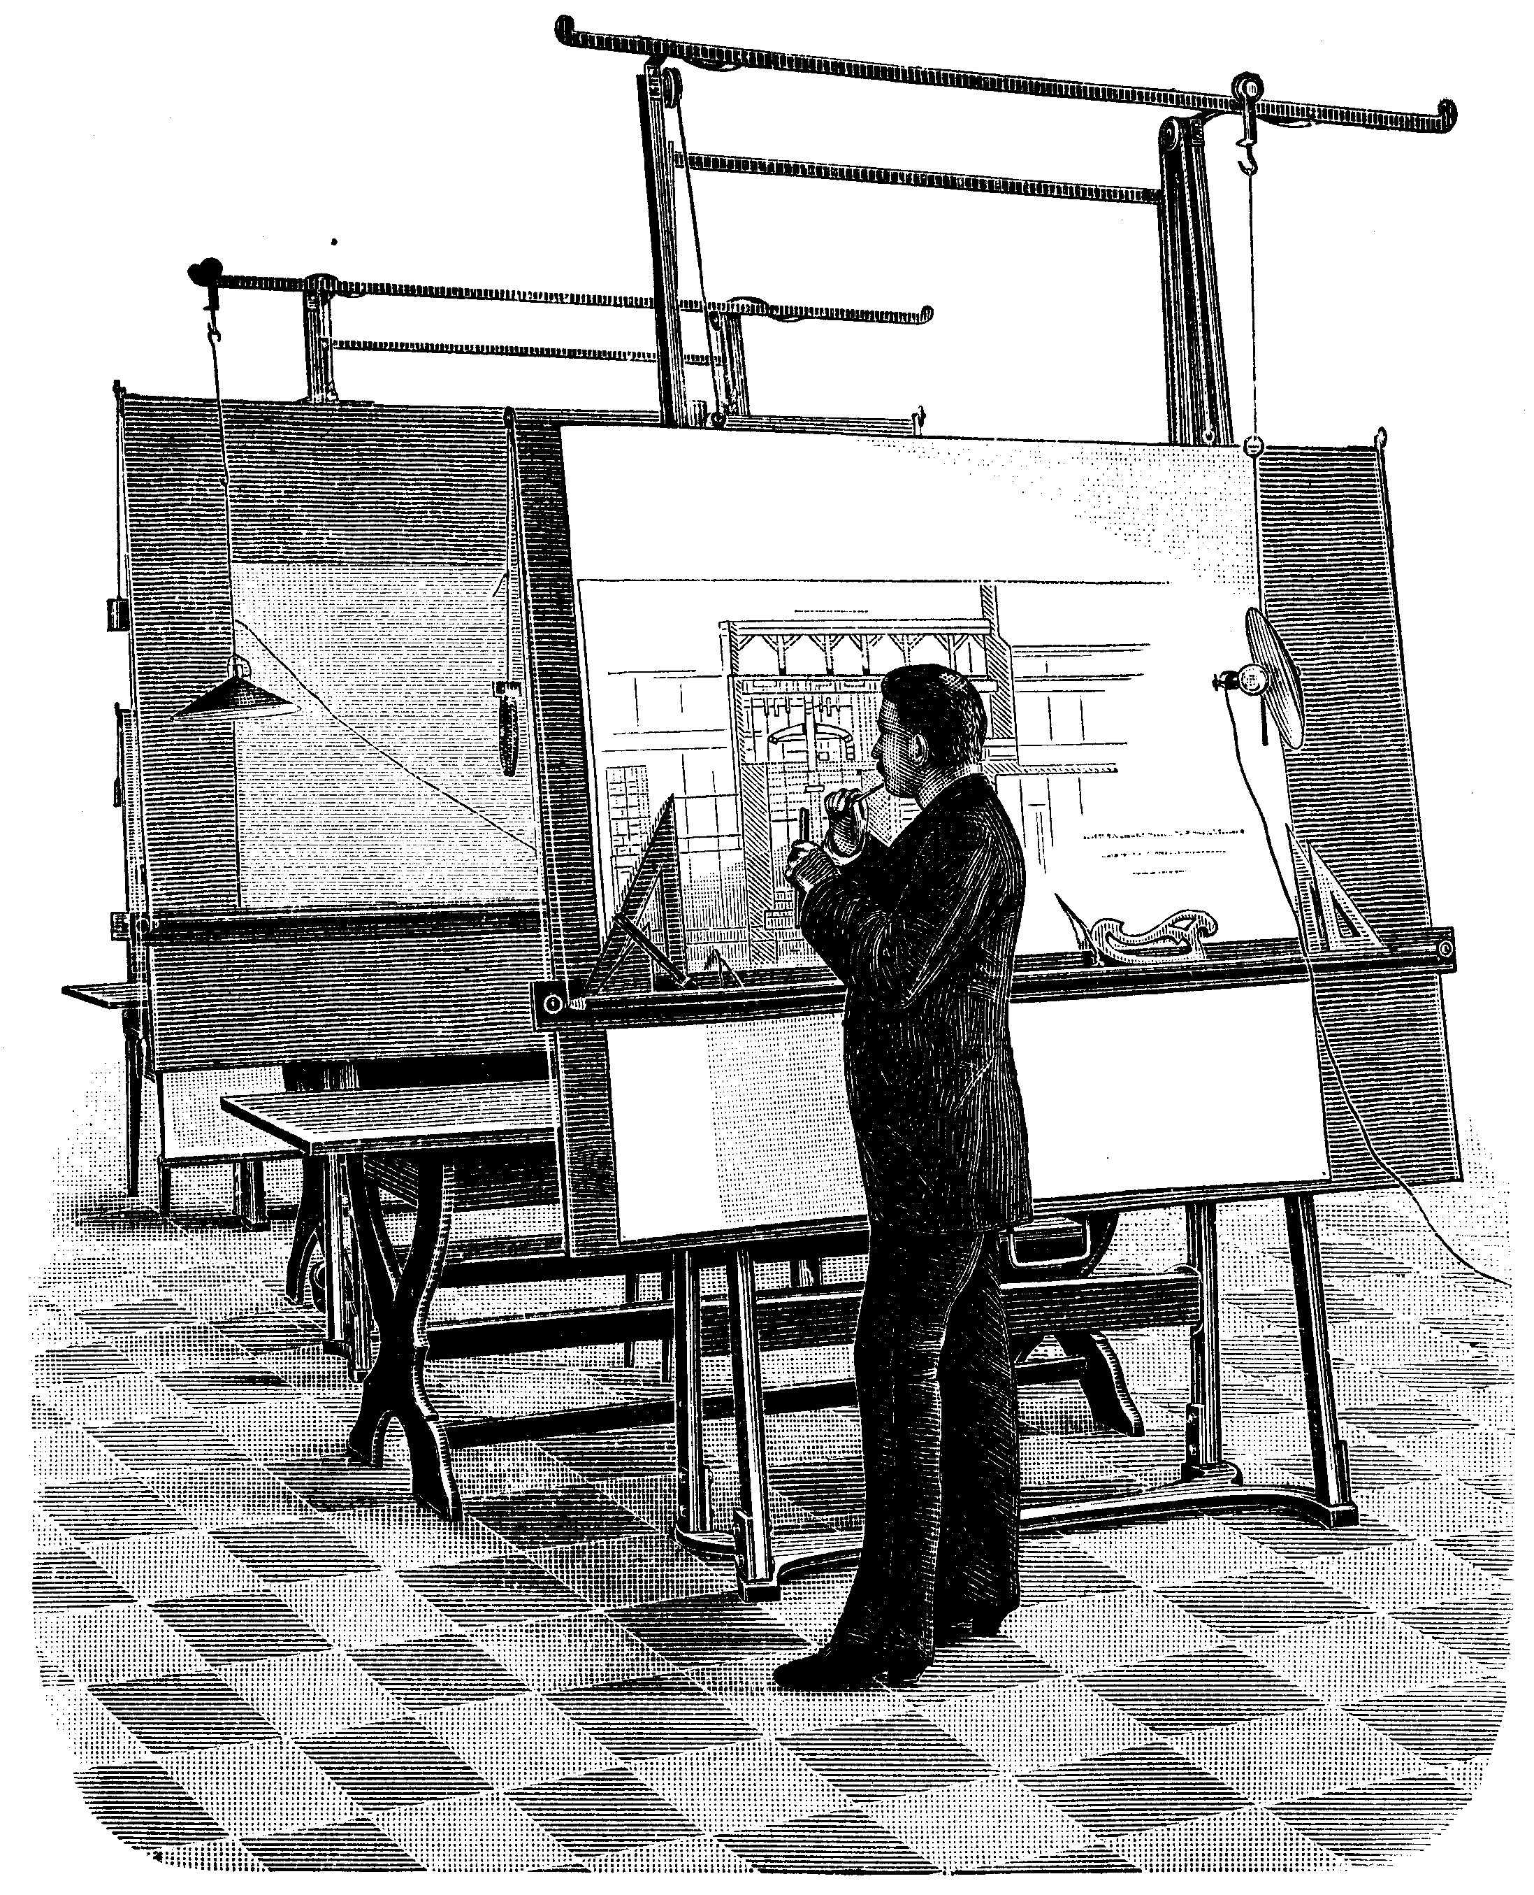
ARCHITECTURE TODAY
How Architecture works
Sketch an idea out
Elaborate and draw plans for your design
Update and keep going until you are done
Worked back when you only needed 20 drawing plans for a house
Not so great when you have 2000+ 30x40 inch sheets to make for today’s projects
Wasteful and limited process

Slide 6
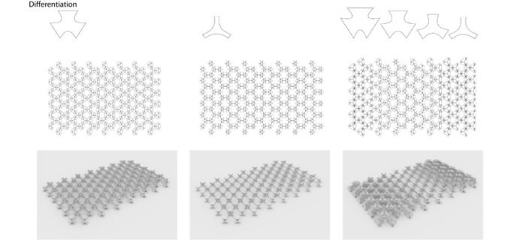
PYTHON IN ARCHITECTURE
Architects are getting more interested in computational design tools
Traditional methods of design and documentation are not sufficient for the needs of Architects today
Python has been the common ground for a lot of Designers to modify the software themselves

Slide 7
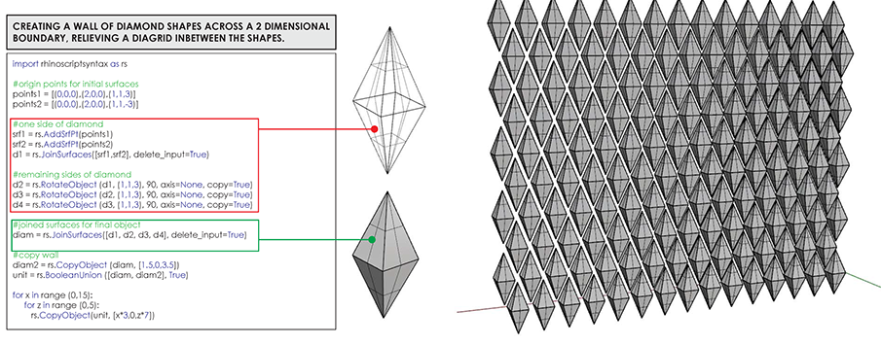
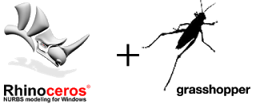
PYTHON IN ARCHITECTURE
Design patterns with Code
Creating custom applications with scripts
Patterns and Parametric designs possible through computational design
Python is increasingly used for both practical scripting and intensive design with algorithms
Curtain Wall geometry using Diamond shapes configured in Python script for Rhino and Grasshopper

Slide 8
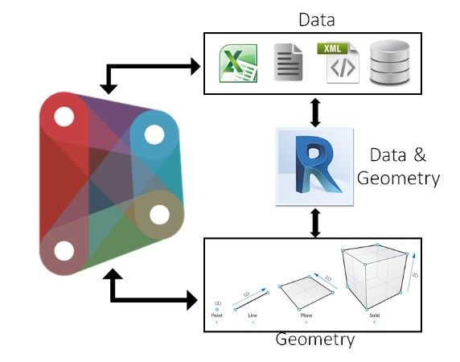
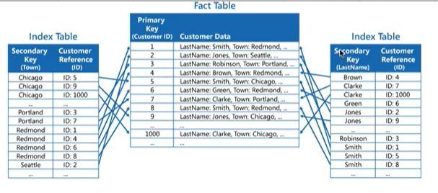
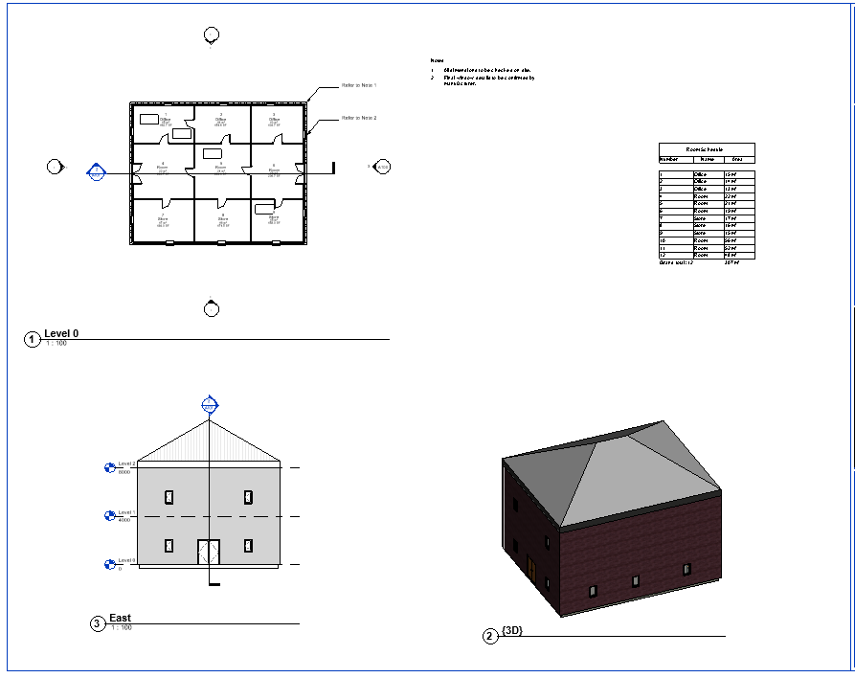
BIM
BIM software is the common data environment for creating building components and documentation
The model elements are embedded with parameter data to inform drawing information
Revit is the largest software install base for BIM with millions of world wide users
Can create 3D models, plans, documentations and drawings for building design and construction
Results in a database you can work with

Slide 9
DYNAMO
Dynamo is from Autodesk and is a Revit add in
Dynamo can let you interact with Revit API using visual scripts and Python without using a SDK
Therefore it is a gateway for coding and opens up a lot of possibilities

Slide 10
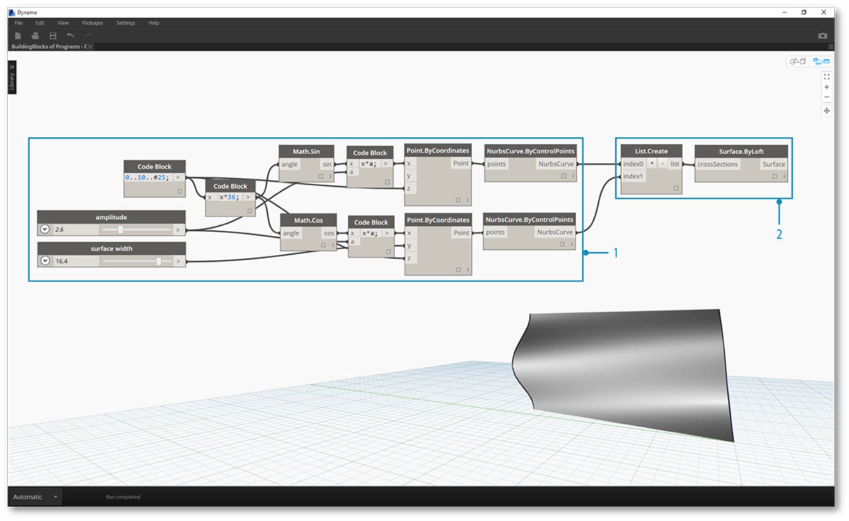
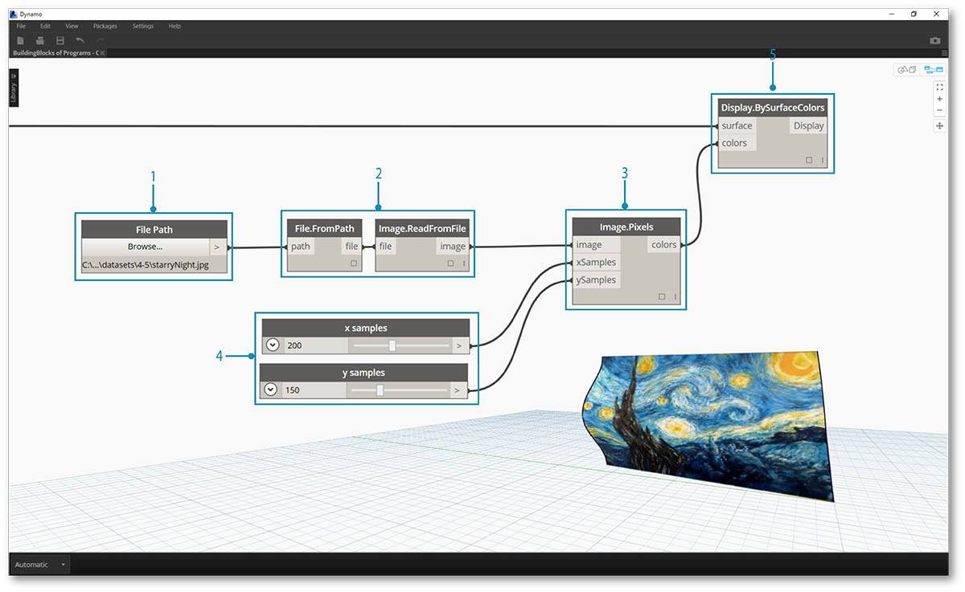
DYNAMO
Connect a series of nodes together into a dataflow to make unconventional content for Revit
Expands the possibilities of designing in a rigid BIM format
Can automate the creation of modeling and documentation
https://primer.dynamobim.org/04_The-Building-Blocks-of-Programs/4-5_color.html

Slide 11
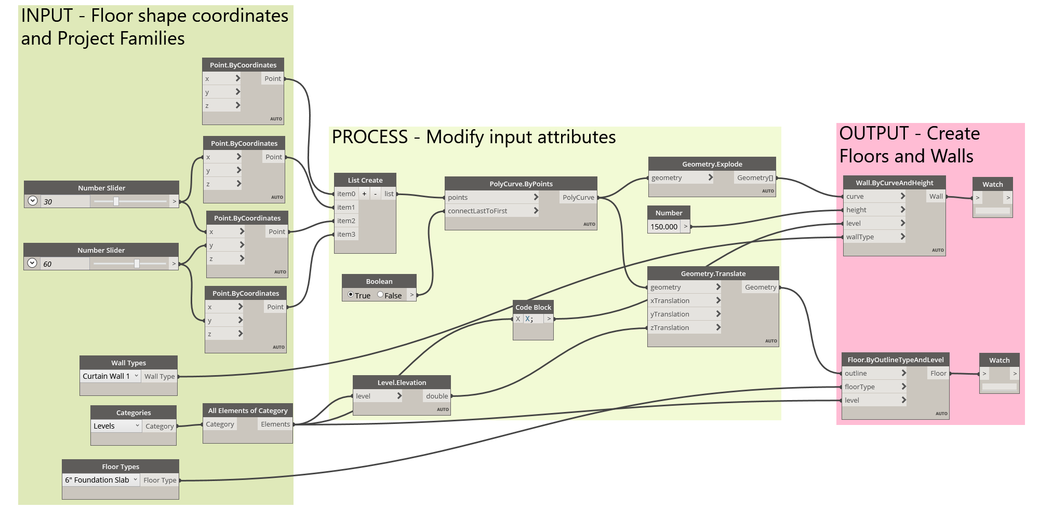
DYNAMO SCRIPT AUTOMATION

Slide 12
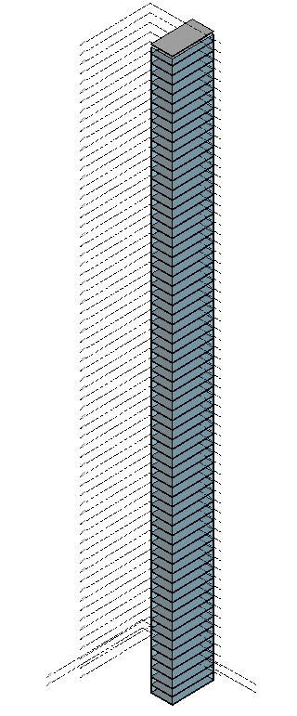
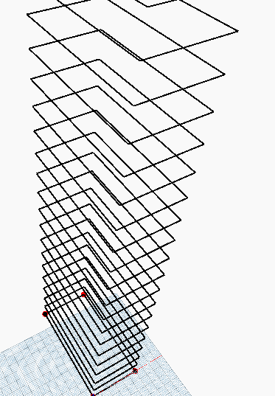
SCRIPTS

Slide 13
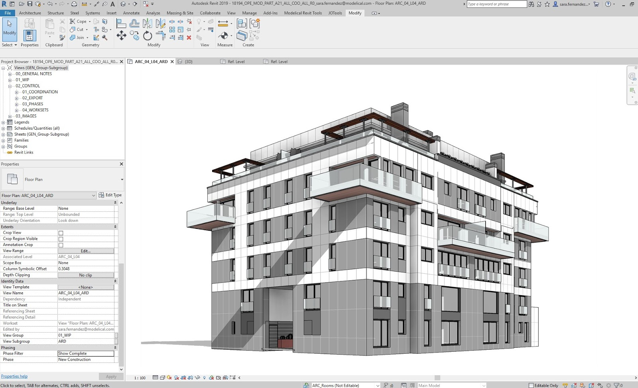
3D MODELING

Slide 14
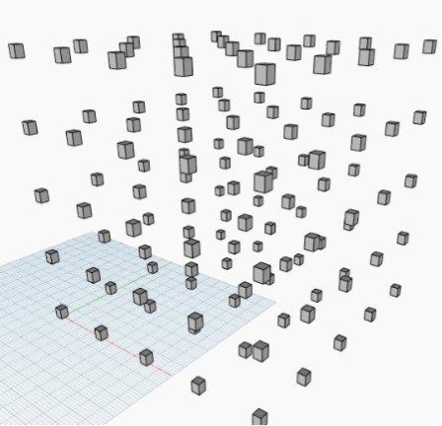
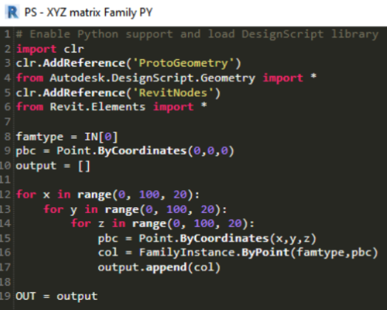
DYNAMO

Slide 15
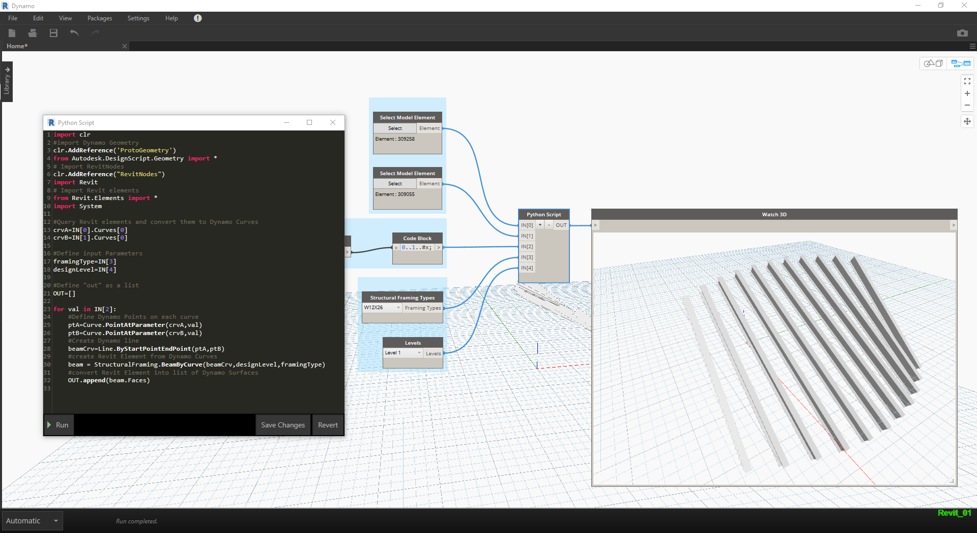
DYNAMO

Slide 16
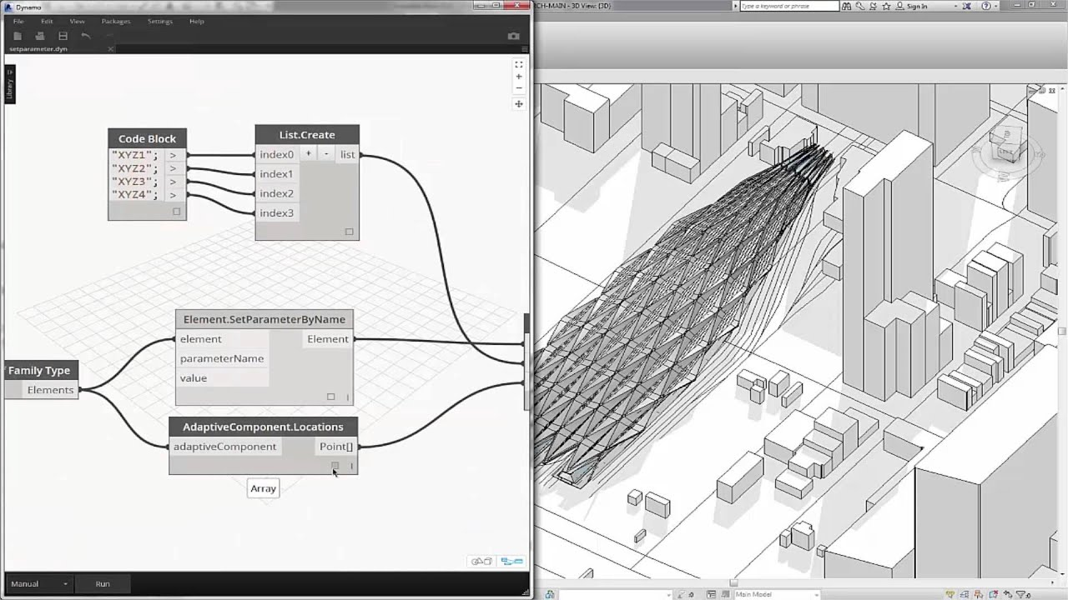
DYNAMO

Slide 17
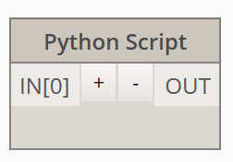
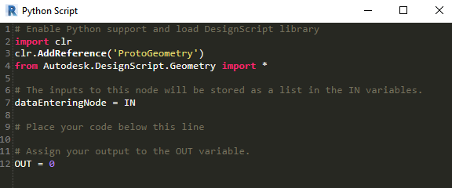
DYNAMO
Nodes in Dynamo allow for Python scripting
Uses IronPython for the compiler

Slide 18
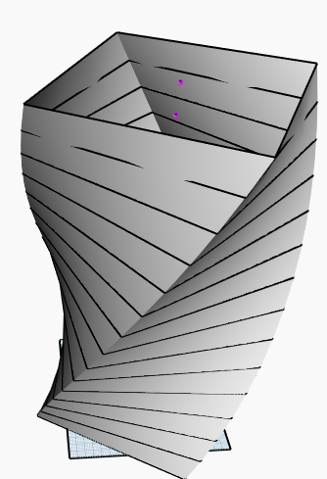
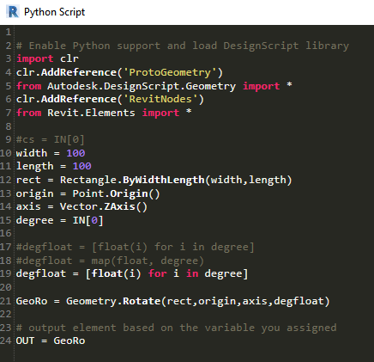
DYNAMO
Makes it easier to modify the design beyond what you can do with the default nodes

Slide 19
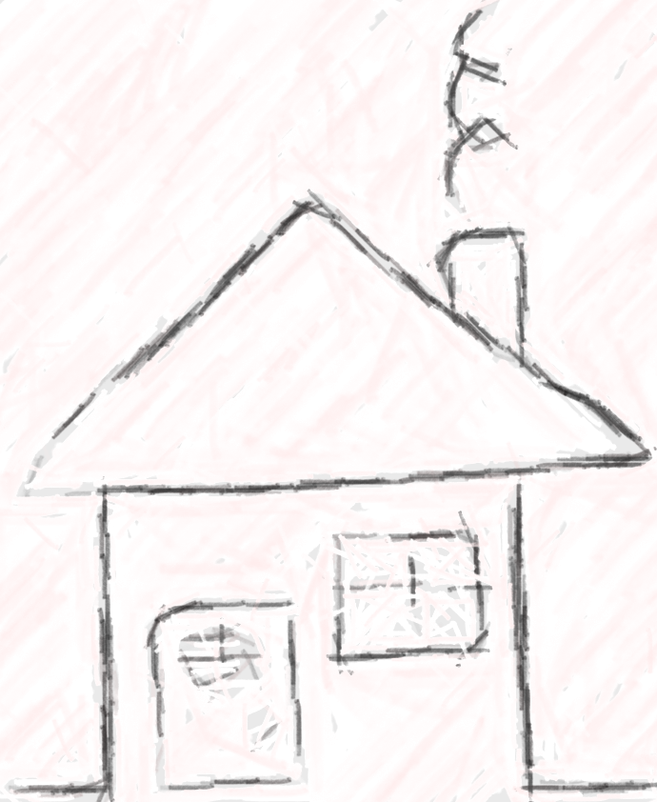
WHAT ABOUT DRAWINGS?

Slide 20

PYREVIT OPEN SOURCE PLUGIN DEVELOPMENT FOR REVIT
pyRevit is a Rapid Application Prototyping (RAD) environment for Autodesk Revit
Open source project for creating custom add ins for Revit
Created so you don’t need to know any C# to create add ins to Revit
Big un-blocker for people of non-CS backgrounds in Architecture
Possible due to IronPython, RPS and RPW projects from other contributors

Slide 21
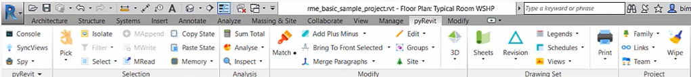
PYREVIT OPEN SOURCE PLUGIN DEVELOPMENT FOR REVIT
Create your own tools without using the software SDK
Uses Revit Python Wrapper (with IronPython) to use Python in a C++ runtime
90% of the work of Architects is documents so this made a big impact in productivity

Slide 22
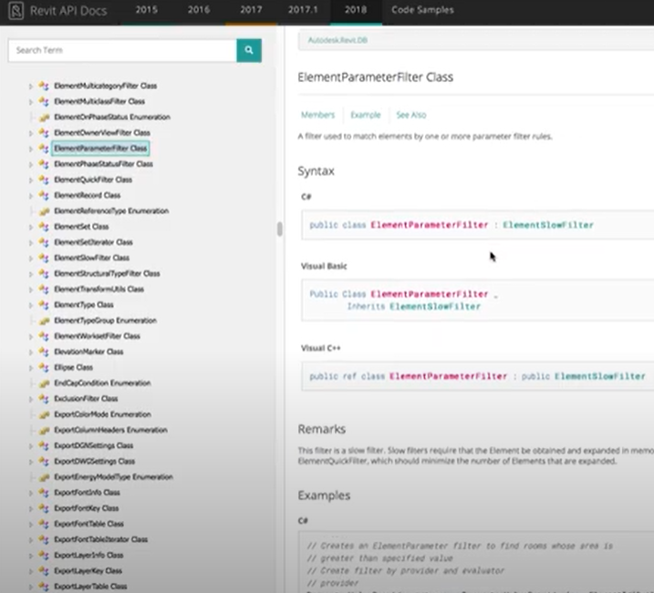
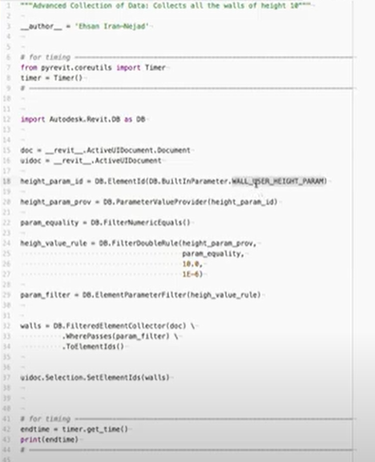
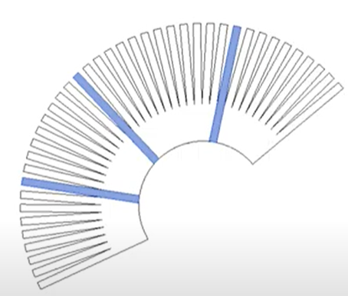
PYREVIT
API calls in C# requires SDK kit to run in .NET
PyRevit takes the calls and can write them in Python code to create custom applications
Allows for editing in the Revit model environment based on custom tools

Slide 23

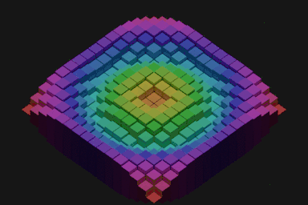
BLENDER 3D IN ARCHITECTURE DESIGN
Blender is gaining a lot of ground with designers
Blender itself is written in Python, C and C++ code with add-ons written in Python being increasingly supported

Slide 24

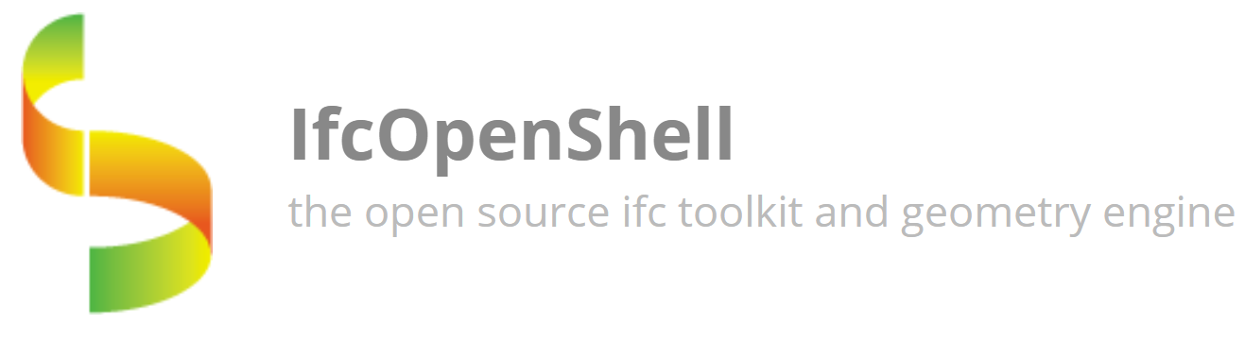
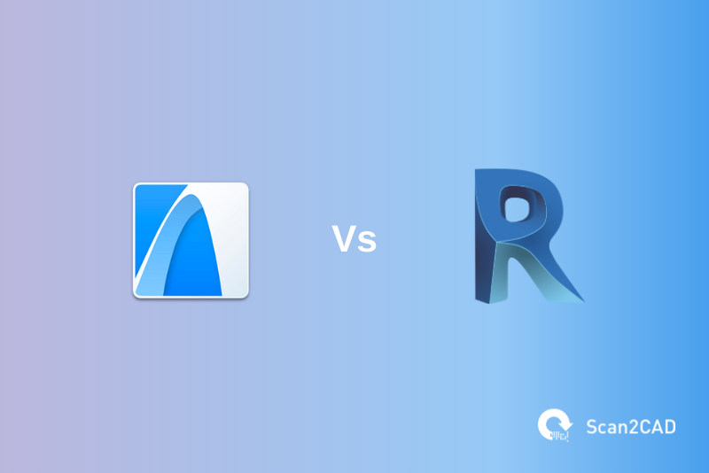
BLENDER BIM BRIDGING THE GAP
BlenderBIM makes the Blender geometry writeable to a BIM format for parametric element modeling
Add on allows data with IFC file format which is interchangeable with many BIM software like Revit or Archicad
Provides a future where designers can use open source tools outside of enterprise suites

Slide 25
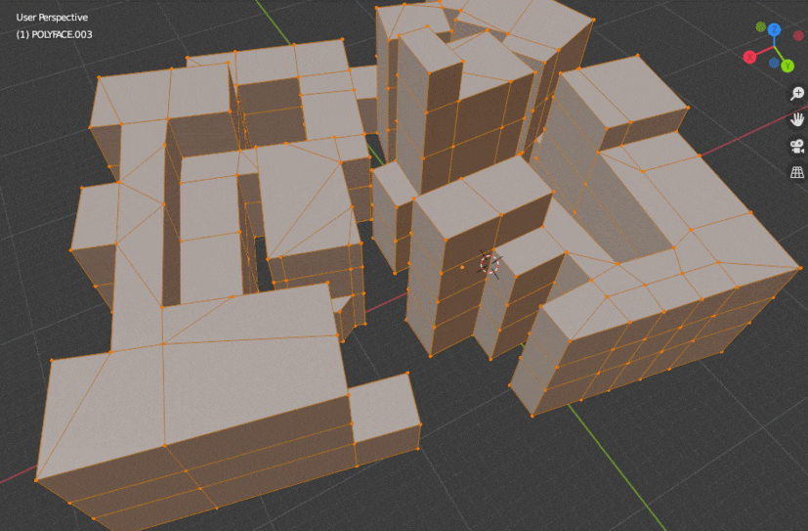

PROCEDURAL MODELING
Source: brunopostle
https://community.osarch.org/discussion/comment/2489/#Comment_2489

Slide 26
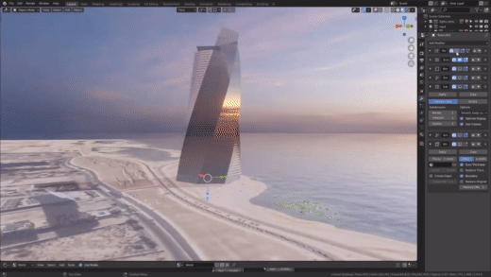
GENERATIVE TOWER DESIGN
From Blender to BIM to design
Source: UH Studio
https://www.youtube.com/watch?v=4LGw1g5sGEo&feature=emb_logo&ab_channel=UHStudio

Slide 27
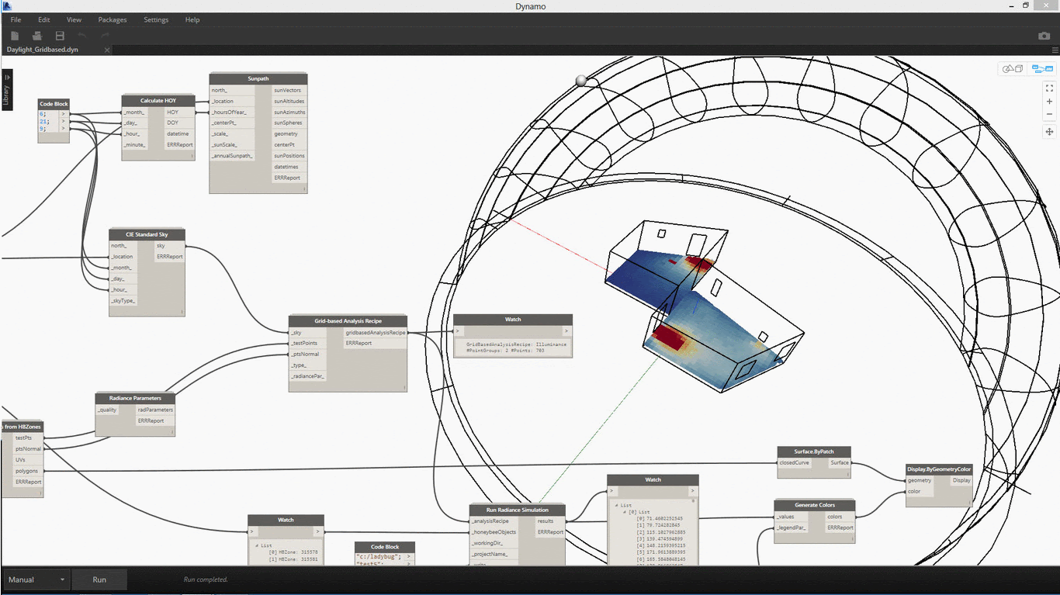

ENERGY SIMULATION
Ladybug Tools is written in Python, which can be run on virtually any operating system and plugged into any geometry engine
pip install lbt-ladybug
Mostapha Sadeghipour Roudsari
https://docs.google.com/presentation/d/1gP5rRtU_DMiP53koQZJrqHoN6q3zaKBEQDPk7CoUkEo/edit#slide=id.g4515a63eb8_0_622

Slide 28
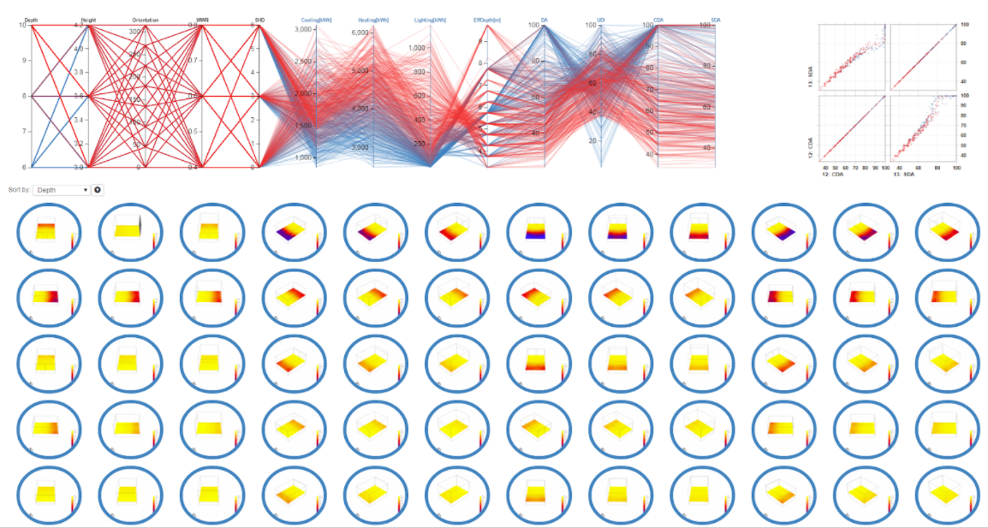
ENERGY SIMULATION - OPTIONEERING

Slide 29
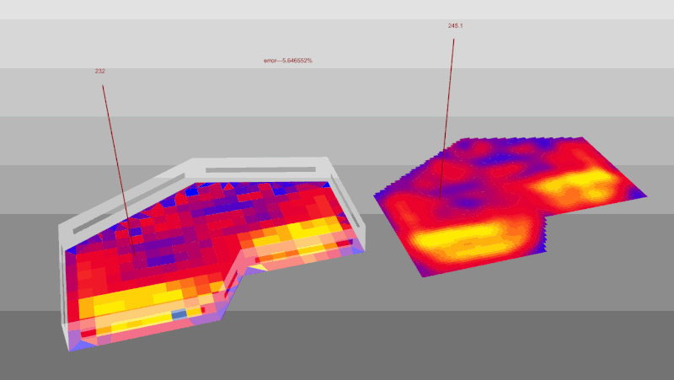

DAYLIGHT SIMULATION
Honey bee is a Python library to create run and visualize the results of daylight and energy analysis

Slide 30
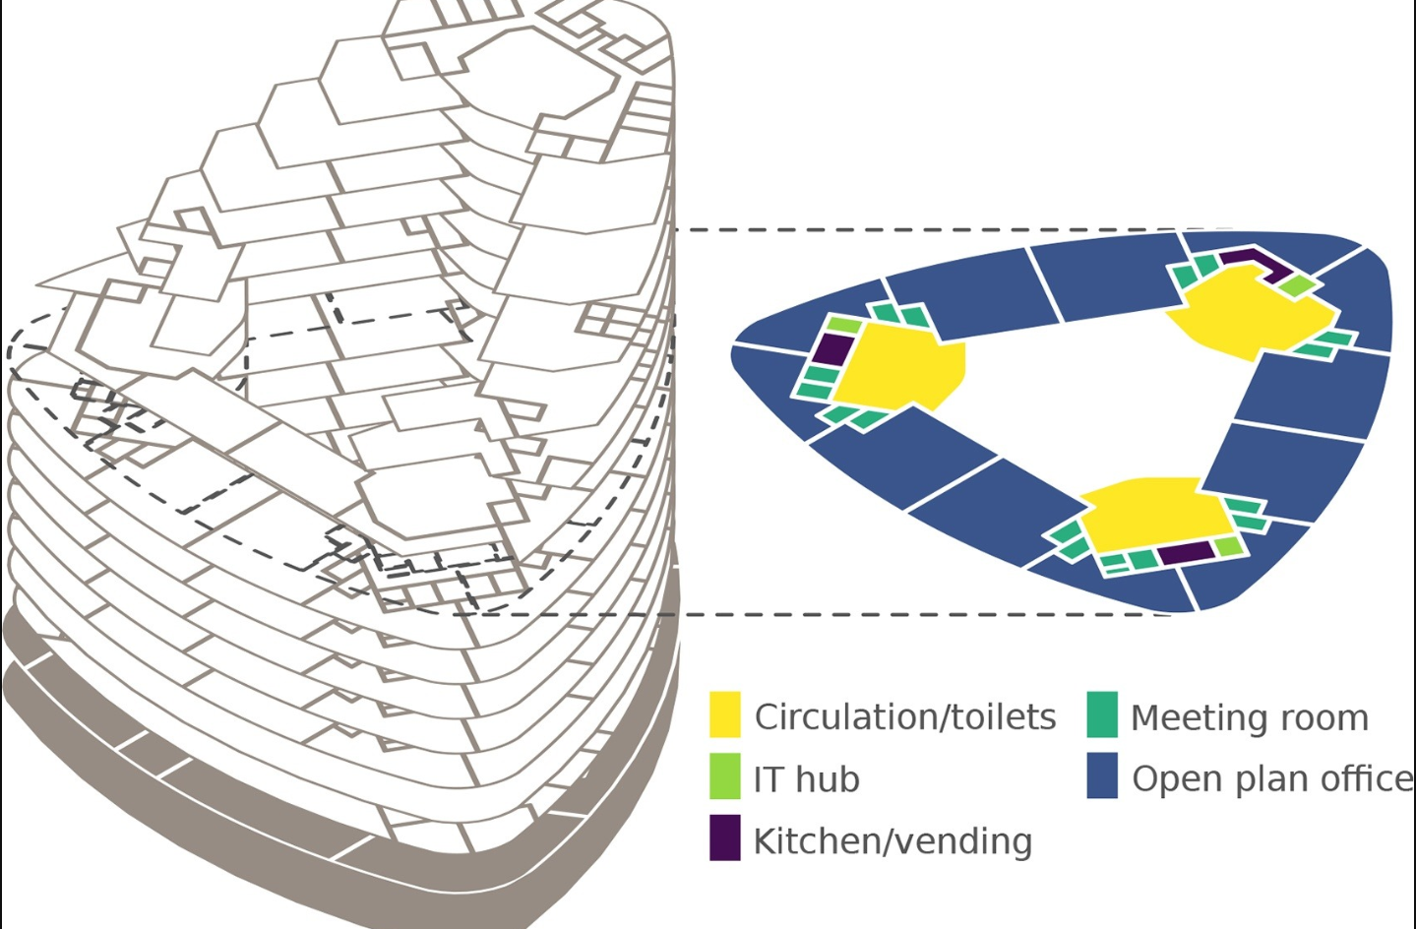
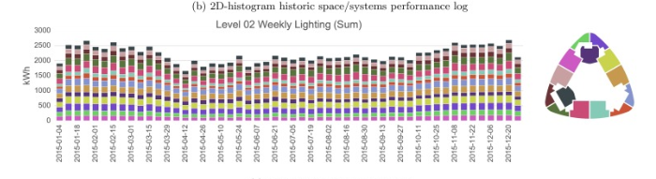
FUTURE OF PYTHON IN ARCHITECTURE
On top of all that Python is a great integrator of tools.
All data is fluid meaning you can take the data you want out of a given software and move it into another.
XML, CSV, HTML, JSON and other document formats can easily let you transfer data around.

Slide 31
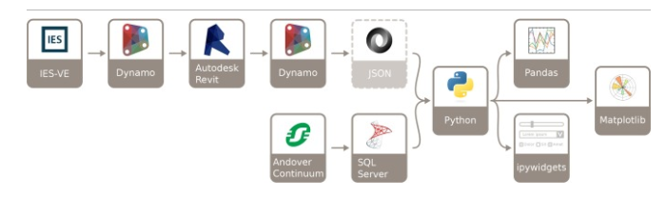
FUTURE OF PYTHON IN ARCHITECTURE
On top of all that Python is a great integrator of tools.
XML, CSV, HTML, JSON and other document formats can easily let you transfer data around.
Helps designers escape from enterprise software into open source ecosystem

Slide 32
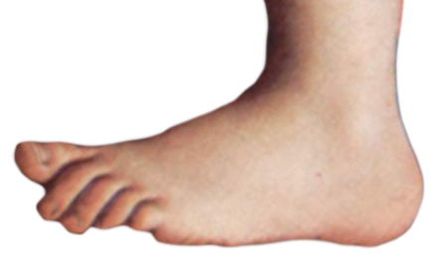

PROGRAMMING SHOULD BE FUN

Slide 33
CONTRIBUTORS AND OPEN SOURCE PROJECTS
Pattern Language - https://www.patternlanguage.com/
Dynamo - https://primer.dynamobim.org/10_Custom-Nodes/10-4_Python.html
Grasshopper - https://developer.rhino3d.com/guides/rhinopython/your-first-python-script-in-grasshopper/
Revit Python Shell - https://github.com/architecture-building-systems/revitpythonshell
Revit Python Wrapper - https://revitpythonwrapper.readthedocs.io/en/latest/
Revit API docs - https://www.revitapidocs.com/
PyRevit - https://www.notion.so/pyRevit-bd907d6292ed4ce997c46e84b6ef67a0
BlenderBIM - https://blenderbim.org/
ifcOpenShell - http://ifcopenshell.org/
Ladybug tools - https://www.ladybug.tools/
Special Thanks to:
Gui Talarico (Revit API docs, Revit Python Wrapper)
Ehsan Iran-Nejad (pyRevit)
Dimon Moult (Blender BIM)
Mostapha Sadeghipour Roudsari (Ladybug Tools)
Dynamo Team

Slide 34
TAKEAWAY
Python Makes it possible!

Slide 35


Thanks everyone!
Tadeh Hakopian Contact Information:
Twitter: https://twitter.com/tadeh_hakopian
Linkedin: https://www.linkedin.com/in/thakopian/
Github: https://github.com/thakopian
Email: thakopian@gmail.com
LINK TO LINKEDIN (NO RICK ROLLING – PROMISE!)
@tadeh_Hakopian
thakopian@gmail.com

